Slide 1
MEMORY MANAGEMENT IN R
May 2018
Bangalore

Slide 2
Memory Management
➢ Vectors are variables with one or more than one values of the same type: logical, integer, real, complex, string.
➢ Vectors could also have length 0
➢ Values can be assigned to vectors in many different ways.
➢ One can type the values into the command line, using the concatenation function c.
➢ Filtering of vectors can be done using three different functions:
• Which()
• Subset()
• expression
………..

Slide 3
WHAT IS A STRING?
➢ Character strings are defined in double quotations.
➢ Numbers can be characters but characters cannot be numbers.
➢ One of the confusing things about character strings is the distinction between the length of a character object (a vector)
and the numbers of characters in the strings comprising that object.
➢ There are built-in vectors in R that contain the 26 letters of the alphabet both in lowercase and in upper case.
………..

Slide 4
STRINGS
➢ Strings are implemented to,
• Know all the matches between one character vector and another
• Find the locations in the first-named vector of any and all of the entries in the second-named vector
• Know what the matches are and their location
• %in% operator for string match
➢ Usage of Paste function
➢ R function to concatenate several strings into one string is paste
➢ If one of the arguments to paste is a vector, each of the elements of the vector is pasted to the specified character
string to produce an object of the Same length as the vector
➢ There are two kinds of paste functions in base R:
• Paste with a single space
• Paste without spaces
………..

Slide 5
STRINGS
➢ Usage of Paste function
➢ R function to concatenate several strings into one string is paste
➢ If one of the arguments to paste is a vector, each of the elements of the vector is pasted to the specified character
string to produce an object of the Same length as the vector
➢ There are two kinds of paste functions in base R:
• Paste with a single space
• Paste without spaces
………..

Slide 6
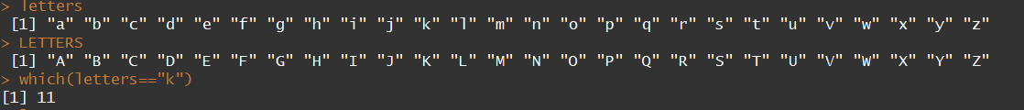
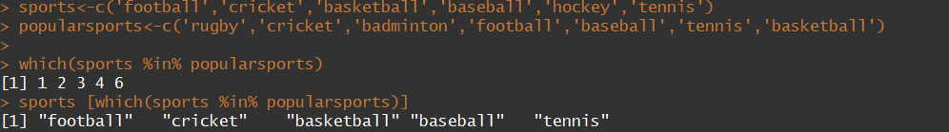
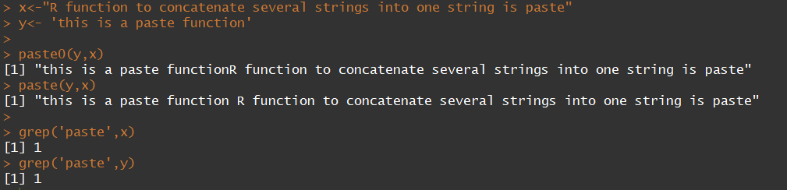
STRINGS(Extended)
………..

Slide 7
Memory Management
➢ Help you predict how much memory you’ll need for a given task
➢ Help you to make the most of the memory you have
➢ Help you write faster code because accidental copies are a major cause of slow code
➢ Help you understand memory usage in R, we will start with pryr::object_size()
➢ Help you to know how many bytes of memory an object occupies
➢ Object_size() function is better than the built-in function object.size()
• Because it accounts for shared elements within an object and includes the size of environments
………..

Slide 8
Memory Management
➢ Every length 0 vector occupies 40 bytes of memory
➢ Those 40 bytes are used to store four components possessed by every object in R:
• Object metadata (4 bytes) - These metadata store the base type (e.g. integer) and information used for debugging
and memory management.
• Two pointers - One to the next object in memory and one to the previous object (2 * 8 bytes). This doubly-linked
list makes it easy for internal R code to loop through every object in memory.
• A pointer to the attributes (8 bytes).
………..

Slide 9
Memory Allocation
➢ All vectors have three additional components:
• The length of the vector (4 bytes).
• By using only 4 bytes, you might expect that R could only support vectors up to 24 × 8 − 1 (231, about two
billion) elements.
• But in R 3.0.0 and later, you can actually have vectors up to 252 elements. Read R-internals to see how
support for long vectors was added without having to change the size of this field.
• The “true” length of the vector (4 bytes).
• This is basically never used, except when the object is the hash table used for an environment.
• In that case, the true length represents the allocated space, and the length represents the space currently
used.
• The data (?? bytes).
• An empty vector has 0 bytes of data.
• Numeric vectors occupy 8 bytes for every element, integer vectors 4, and complex vectors
………..

Slide 10
Memory Management
➢ But why does the memory size grow irregularly?
➢ To understand why, you need to know a little bit about how R requests memory from the operating system.
➢ Requesting memory with malloc() is a relatively expensive operation.
➢ Having to request memory every time a small vector is created would slow R down considerably.
➢ Instead, R asks for a big block of memory and then manages that block itself.
➢ This block is called the small vector pool and is used for vectors less than 128 bytes long.
➢ For efficiency and simplicity, it only allocates vectors that are 8, 16, 32, 48, 64, or 128 bytes long.
………..

Slide 11
Memory Management
➢ A subtlety of the size of an object is that components can be shared across multiple objects.
➢ For example, look at the following code:
• y isn’t three times as big as x because R is smart enough to not copy x three times; instead it just points to the existing x.
• It’s misleading to look at the sizes of x and y individually.
• If you want to know how much space they take up together, you have to supply them to the same object_size() call
• x and y together take up the same amount of space as y alone
………..

Slide 12
Sorting And Merging In Dataframe
➢ To sort a data frame in R, use the order( ) function.
➢ By default, sorting is ASCENDING.
➢ Prepend the sorting variable by a minus sign to indicate DESCENDING order.
➢ Merge function is used to merge two data frames (datasets) horizontally.
➢ In most cases, you join two data frames by one or more common key variables
(i.e., an inner join).
➢ Brand names are the common column between data frame A and B.
➢ rbind() function is used to join two data frames (datasets) vertically.
➢ The two data frames must have the same variables, but they do not have to
be in the same order.
………..

Slide 13
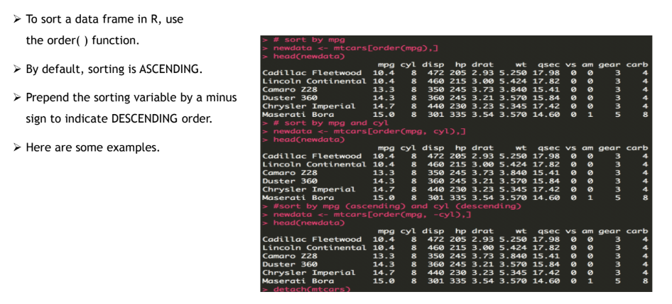
Sorting

Slide 14
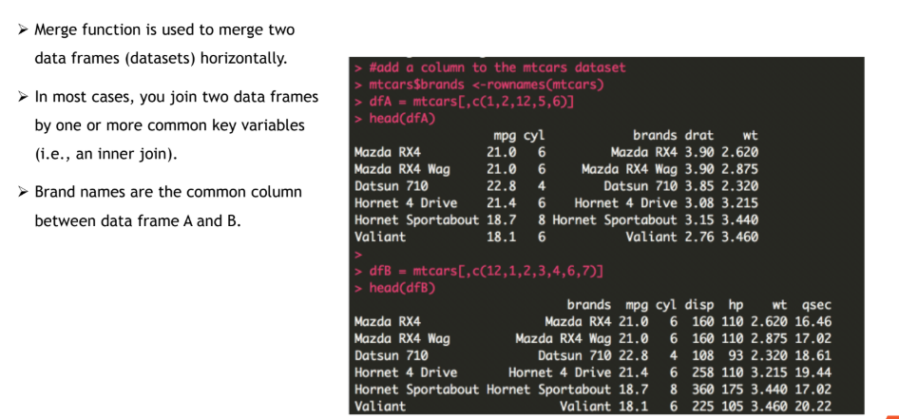
Merging

Slide 15
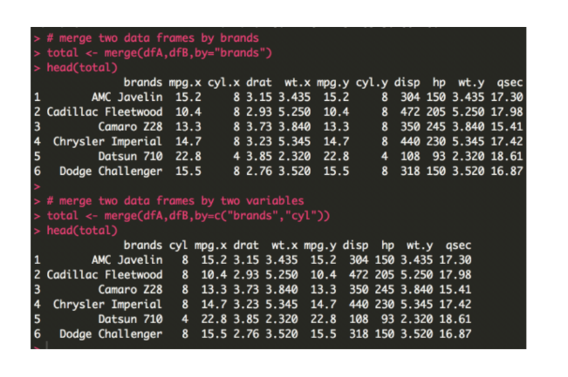
Merging

Slide 16
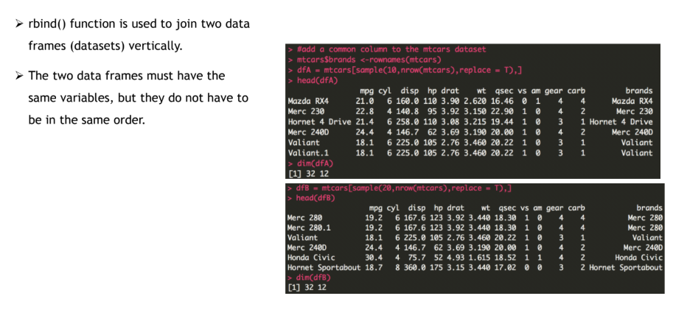
Merging

Slide 17
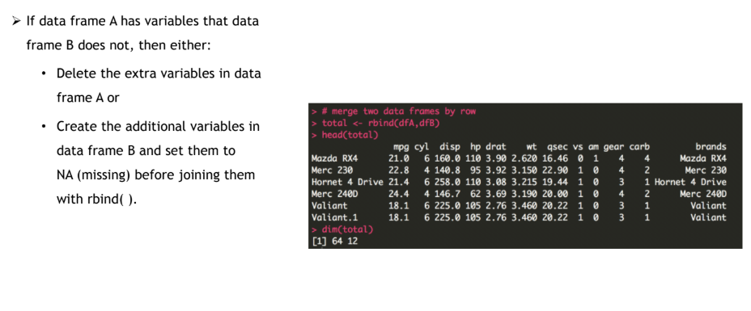
Merging

Slide 18
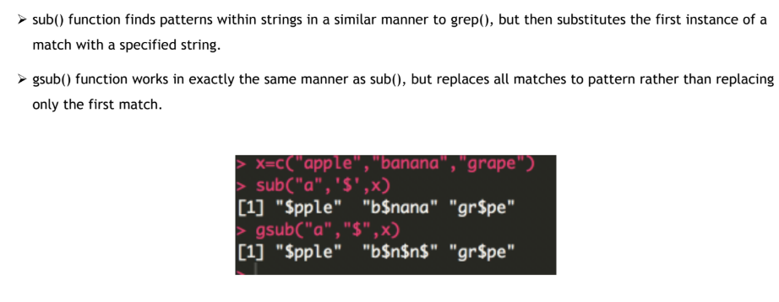
sub() and gsub()

Slide 19
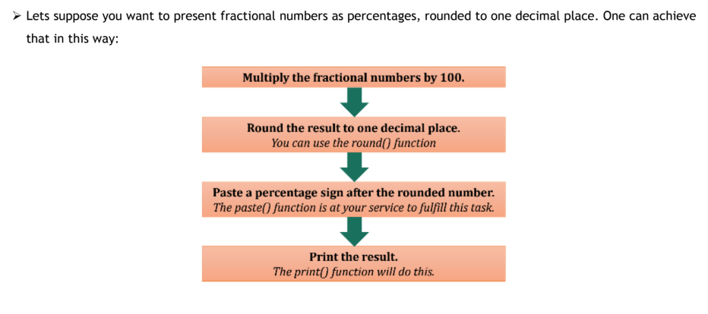
Make a Script

Slide 20
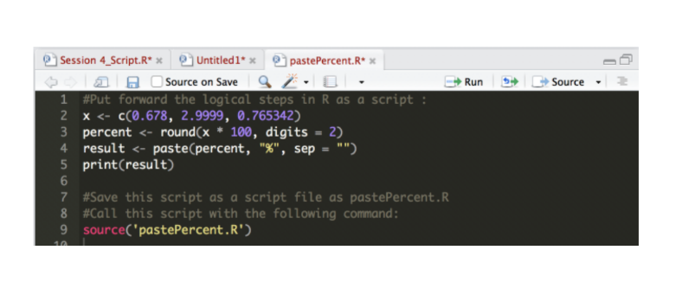
Call a Script

Slide 21
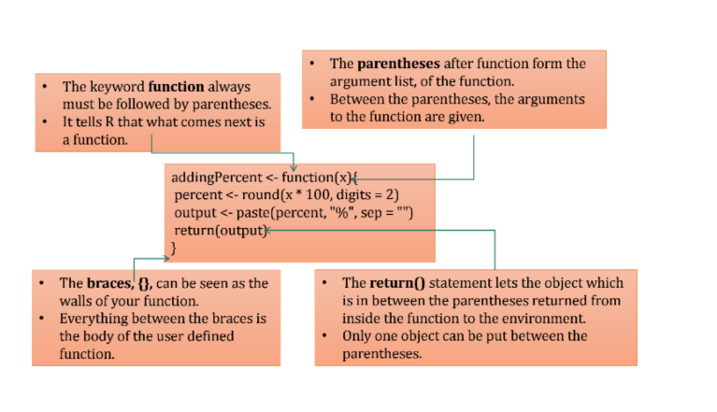
Control Flow Structures in R

